Slide 1

GITHUB REPOSITORY
https://github.com/nikhilracha/jobster

Slide 2
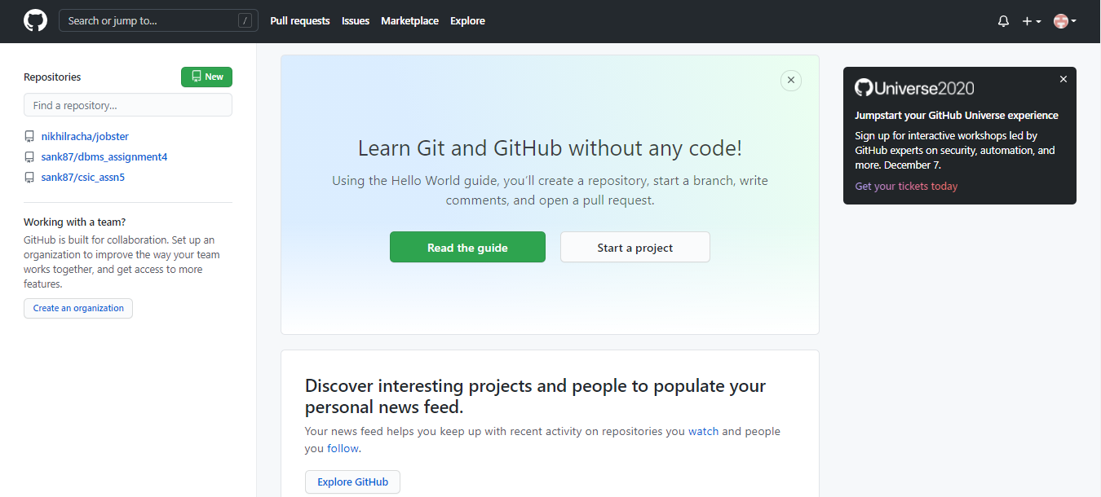
GitHub Login Landing Page

Slide 3
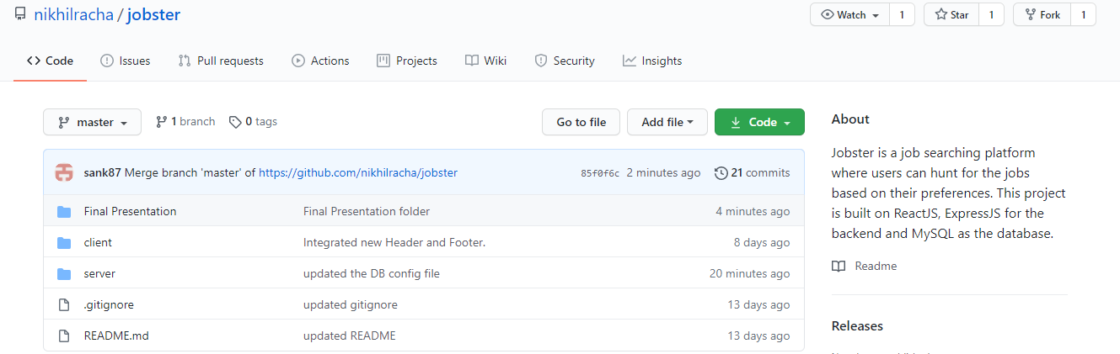
ROOT Folder

Slide 4
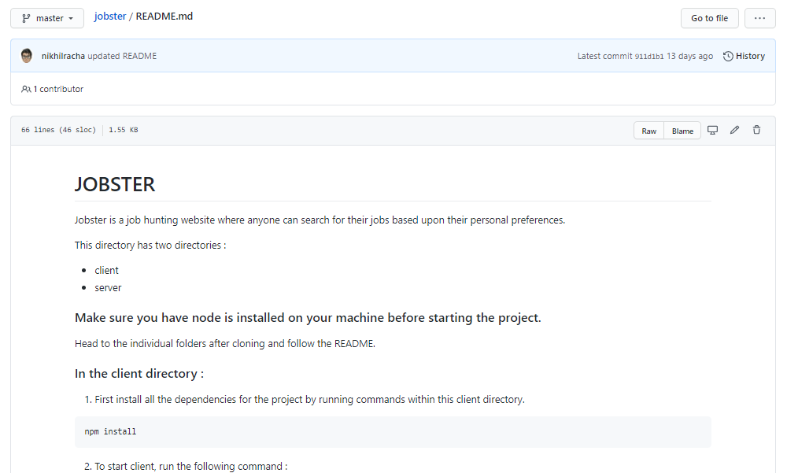
README.md

Slide 5
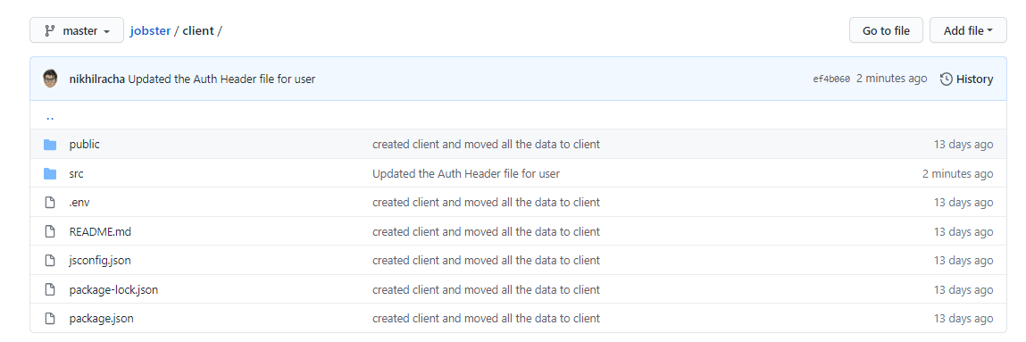
Client Folder

Slide 6
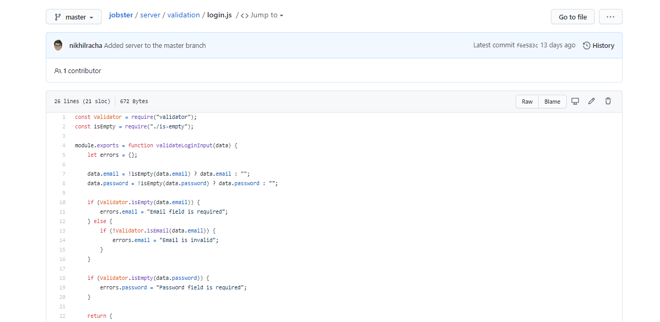
User Login (login.js)

Slide 7
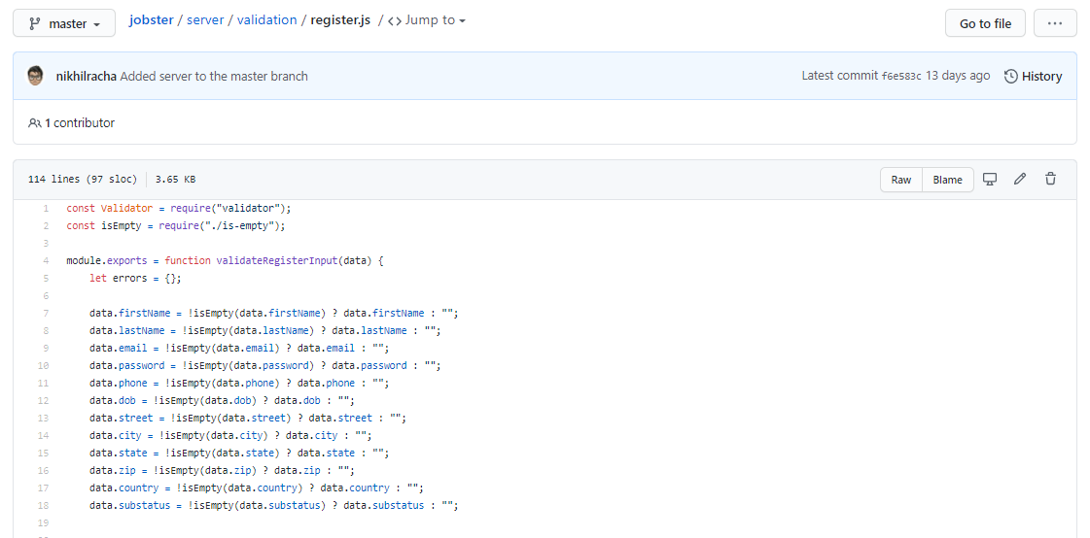
User Register (register.js)

Slide 8
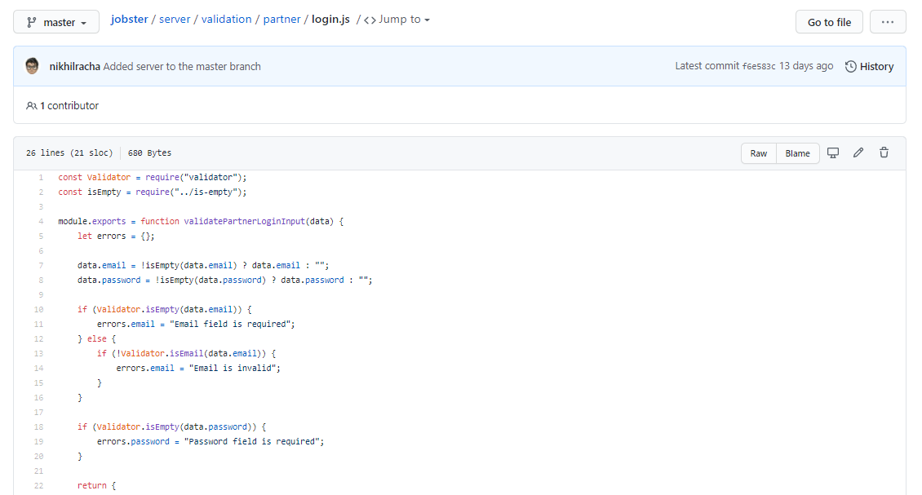
Partner Login (login.js)

Slide 9
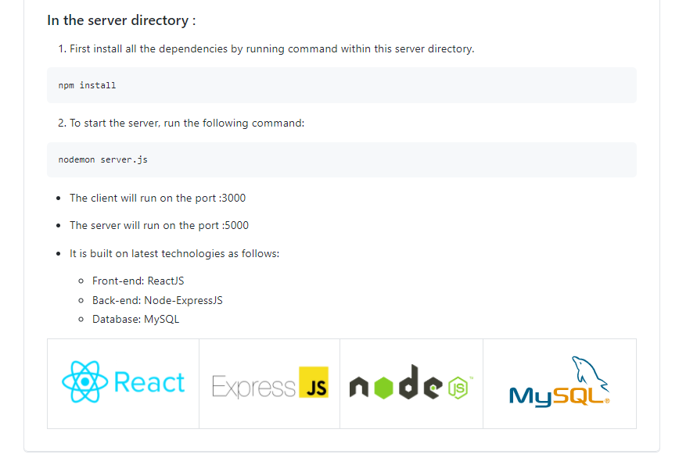
Deployment Process

